Slide 1

Life Science
Hack 2025
Predicting Medical Equipment Failure

Slide 2
Life Science
Hack 2025
PROBLEM STATEMENT
Predicting Medical Equipment Failure
Predicting medical device failure is crucial for ensuring patient safety, minimizing downtime, and reducing maintenance costs.
This use case involves leveraging data analytics and machine learning to predict potential failures of medical devices before they occur.
Develop a machine learning algorithm that can predict medical device failures, enabling proactive interventions and maintenance.

Slide 3

Life Science
Hack 2025
SOLUTION
Predicting Medical Equipment Failure
A Machine Learning model (XGBoost algorithm) has been used to predict medical equipment failures before they actually occur, based on inputs such as Device Name, Device Type, Temperature, Pressure, and Vibration etc.
Live streaming data is processed in real time and fed into the model to enable continuous monitoring and prediction.
Failure predictions are generated as responses, providing timely alerts for proactive maintenance.
A user-friendly website displays alerts on potential medical equipment failures, helping ensure preventive action before breakdowns occur.

Slide 4
Life Science
Hack 2025
RESEARCH AND CASE-STUDIES :
On collecting the evidence from the research paper titled ‘Medical Device Failure Predictions Through AI-Driven Analysis of Multimodal Maintenance Records’ (IEEE Access, 2023).
Research shows that 30–40% of hospital equipment downtime is due to preventable failures, directly impacting patient care and safety.
Unplanned failures increase maintenance costs by 25–30% compared to predictive maintenance approaches..
A predictive ML model can reduce downtime, optimize maintenance schedules, cut costs, and ensure higher equipment availability.
This evidence forms the basis for choosing this use case, and our dashboard visualization demonstrates real-time monitoring and proactive alerts.

Slide 5
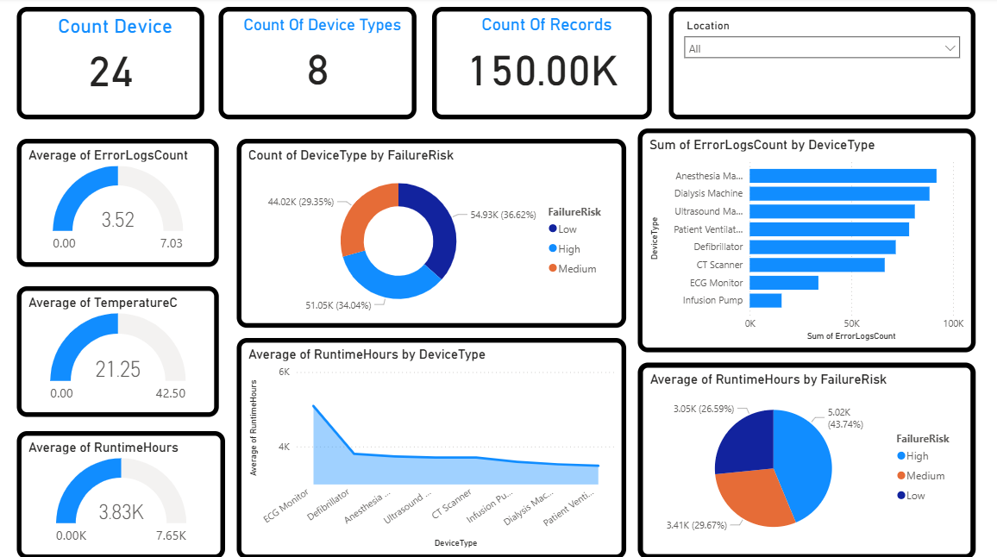

Slide 6

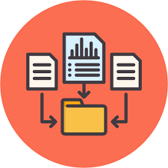



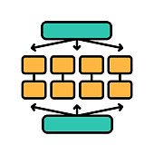
















Predicting Medical Equipment Failure Architecture
Testing Model
XG Boost
Model
Data Collection
Data Preprocessing
Feature Extraction
Training Model
Validate Model
Frontend
Request
Simulate Streaming
Deployment
User
Response
Backend
Predictions
Spark Pipeline
HTML
CSS
Java Script
Python
Prediction Condition
Hive MQ Cloud
Azure Blob Storage

Slide 7
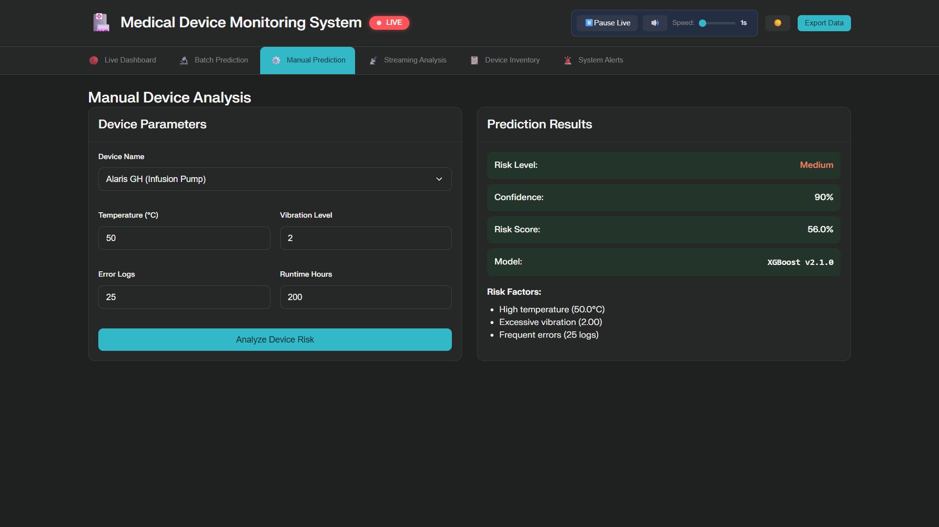
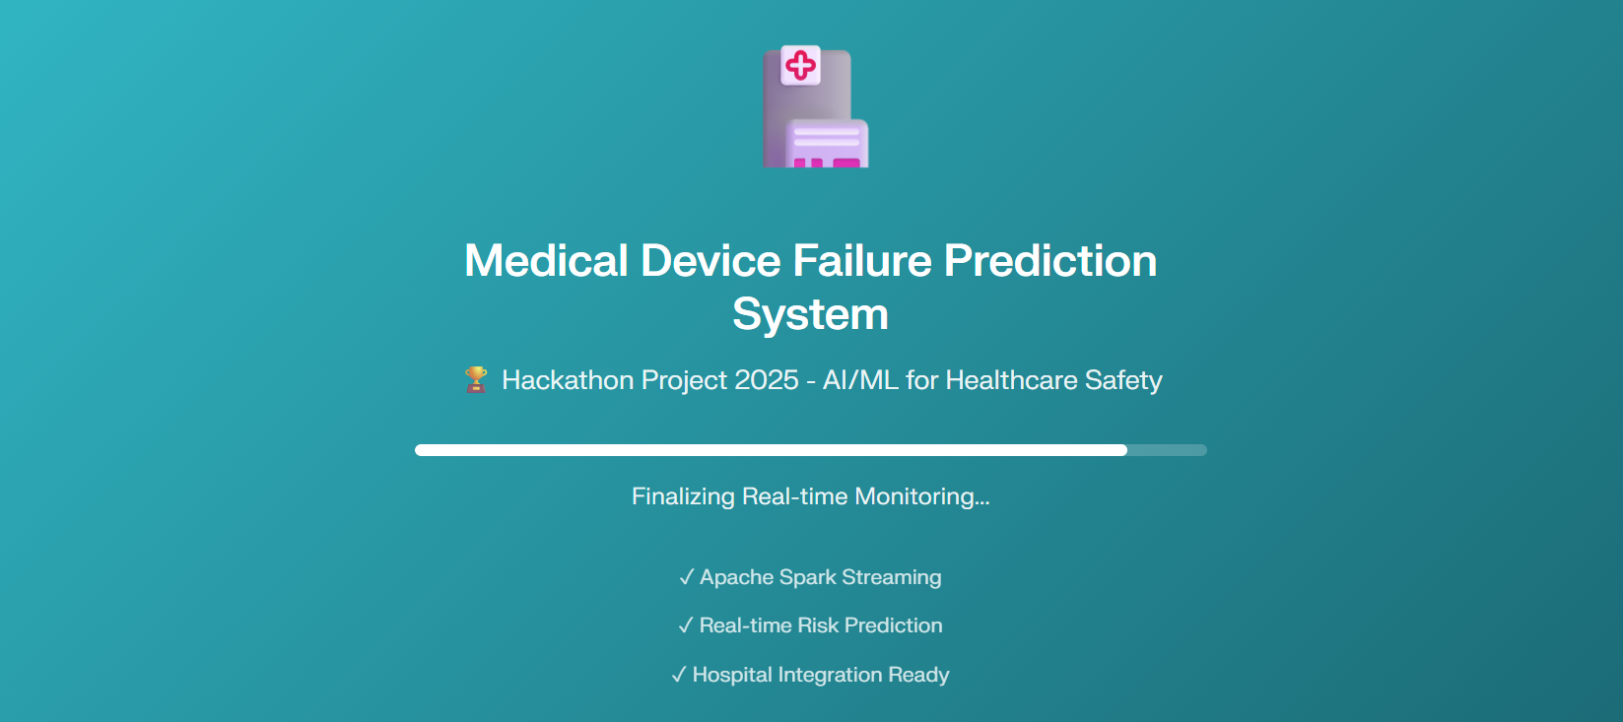
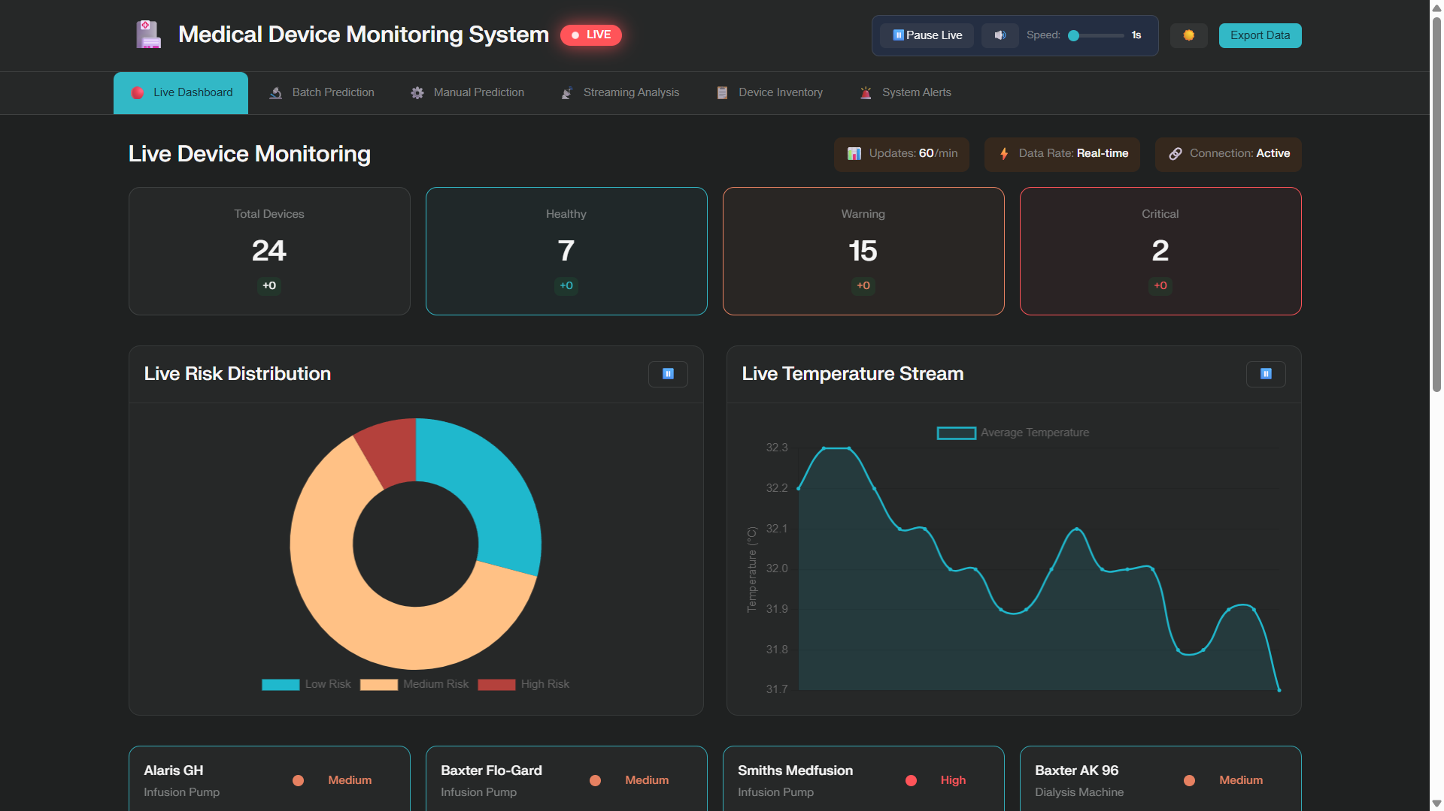
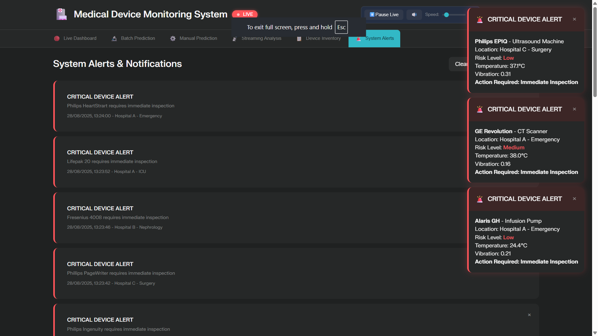
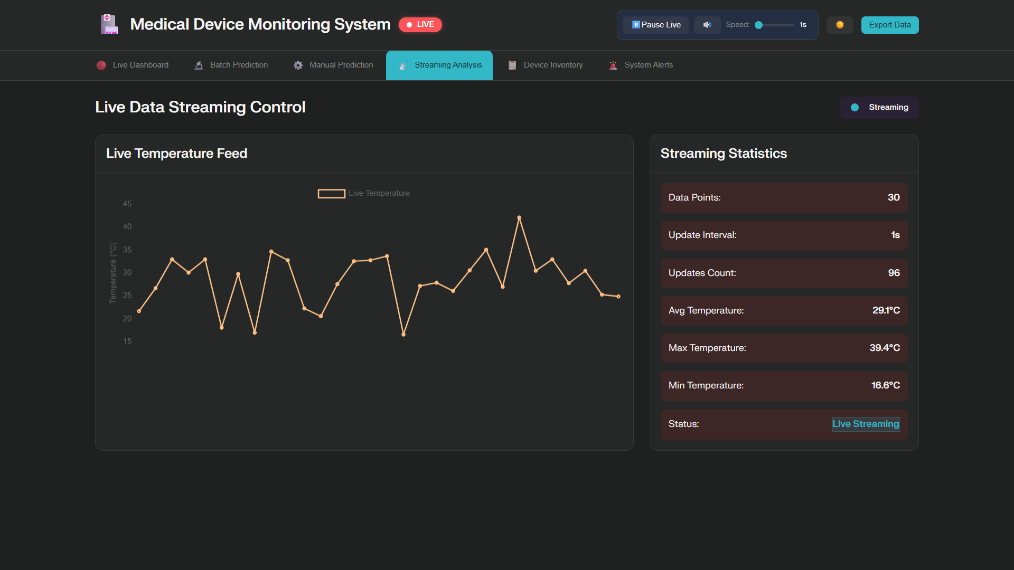
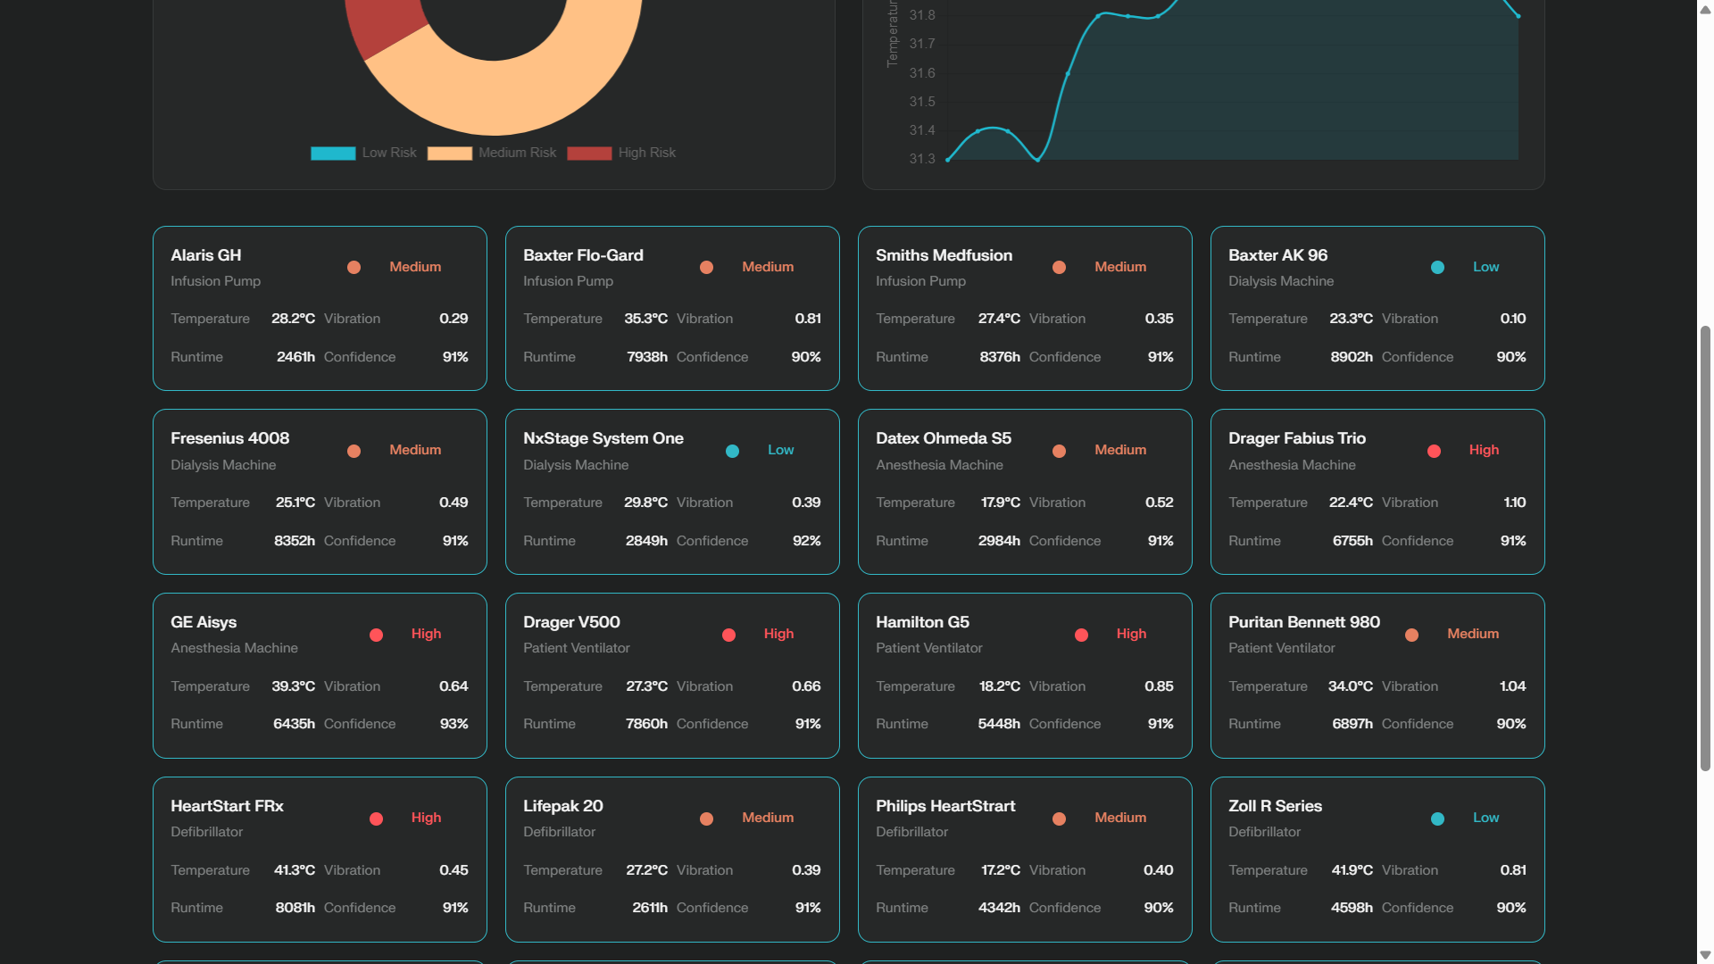
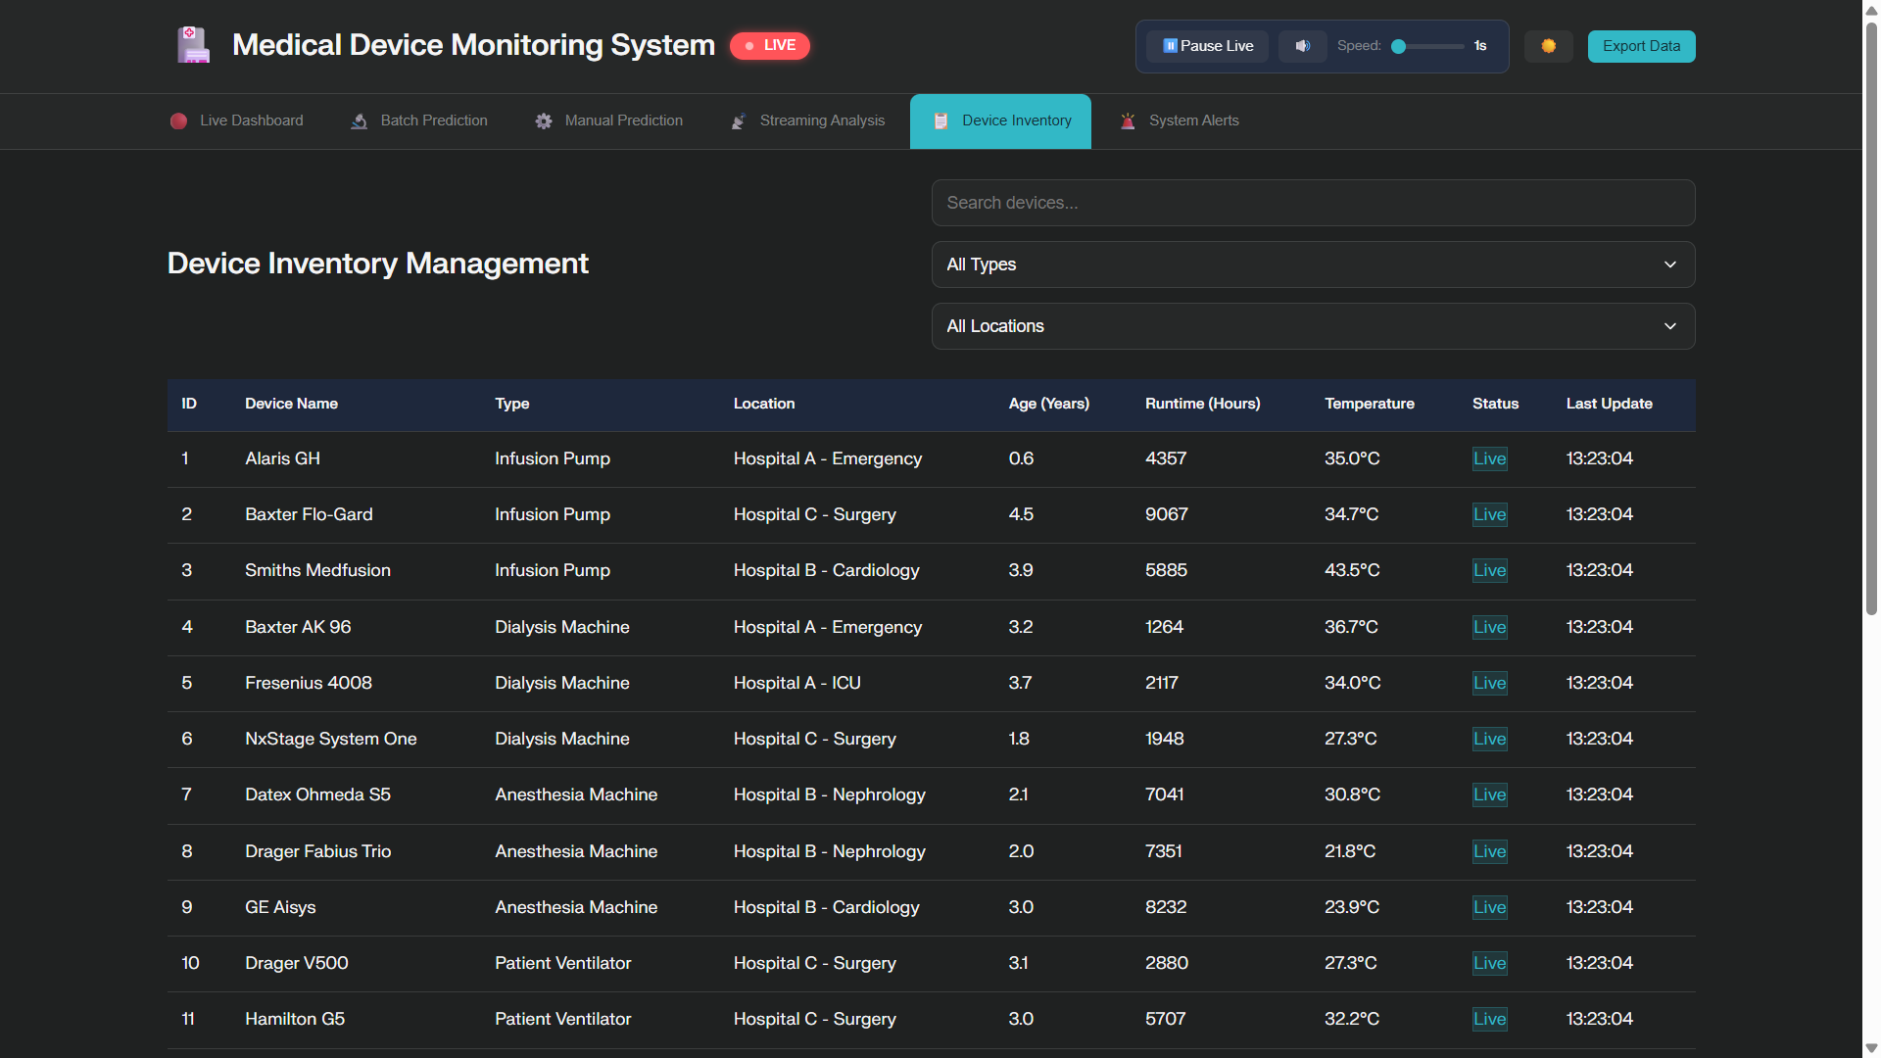
Life Science
Hack 2025
UI WORK FLOW
System Start
Login / System Entry
Run Manual Prediction
Streaming Analytics
View Critical Alerts
Dashboard
Streaming Device Updates
Check Device Inventory

Slide 8
Build trees step by step
Life Science
Hack 2025
MACHINE LEARNING MODELS
XG-Boost Algorithm:
XGBoost (Extreme Gradient Boosting) is a powerful and efficient machine learning algorithm mainly used for classification, regression, and ranking tasks. It is widely preferred for its high performance and ability to handle large datasets effectively.
XGBoost builds an ensemble of decision trees sequentially, where each tree corrects the errors of the previous one using gradient boosting techniques..
STEPS INVOLVED IN XG-Boost :
Start with base prediction
Build trees step by step
Fix errors after each tree
Regularize to avoid overfitting
Combine all trees for final prediction

Slide 9
Life Science
Hack 2025
MACHINE LEARNING MODELS
How XG-Boost algorithm works:
XGBoost works by building an ensemble of decision trees in a sequential manner, where each tree tries to correct the errors made by the previous trees.
At each step, the algorithm calculates gradients and updates the model to minimize the loss function efficiently.
The process continues until the maximum number of trees is built or the model reaches optimal accuracy. Finally, the predictions from all trees are combined to produce the final result.
The general formula for the objective function is:
Obj = Loss + Regularization

Slide 10
Life Science
Hack 2025
MACHINE LEARNING MODELS
Model | How It Works | Accuracy
Logistic Regression | It predicts the probability of equipment failure (e.g., High, Medium, Low) using a linear relationship between input features and the output. | 89.77%
Random Forest | It builds many decision trees on random subsets of data and features, then combines them for final prediction. | 78.29%
XG-Boost | It builds decision trees sequentially, where each new tree focuses on fixing the mistakes of the previous ones, using gradient boosting. | 86.64%

Slide 11
Technology Stack
Frontend and Backend
Programming Language
Python
Streaming Cloud
Hive MQ Cloud
Data Storage
Azure Blob Storage
Deployment

Slide 12
Life Science
Hack 2025
Mentor connect details
Date of connect | Time | Agenda of the meet
22-08-2025 | 11:30 am | Use case review and the Approach has been discussed with mentors. Discussed moving to stream processing, using public data, and adding real-time data ingestion.
26-08-2025 | 2:00 pm | Architecture diagram and the model has been provided to the mentors. Suggestion about making the code modular and adding Azure Blob Storage to store data for future use.

Slide 13

Thank You

